Slide 1
Sealink Maritime VSAT
November 2021

Slide 2
Agenda
About Marlink
Sealink VSAT Overview
Sealink Allowances
Sealink Business
Sealink Premium
Sealink Options – Plus and Companion
Sealink Voice Services
4G Services
Choice of Reliable Equipment
Most Extensive Coverage
Value Added Services
Customer Support
Sealink VSAT Reference Customers

Slide 3
World Maritime Connectivity Leader
Marlink is the preferred VSAT and MSS provider of the maritime industry, proven across multiple 2020 and 2021 market reports
Valour Consultancy
The Future of Maritime Connectivity (Mar 20):
Marlink is number 1 in maritime VSAT market share (24%)
Marlink is number 1 in MSS connectivity market share (23%)
Marlink is number 1 in combined maritime VSAT + MSS connectivity market share (24%)
Northern Sky Research
Maritime Satcom Markets, 8th Edition (May 20):
Marlink has regained the number 1 spot in maritime VSAT revenue for the second year running (24% market share)
Marlink is the world’s largest provider of Maritime MSS services
Comsys Maritime
Comsys Maritime VSAT Report, 5th Edition (Dec 19):
Marlink is the world’s largest provider of maritime VSAT (20% market share)
Euroconsult
Prospects for Maritime Satellite Communications (May 21):
Marlink is the world’s largest provider of maritime VSAT (29% market share)

Slide 4
The Marlink Group
Marlink is the trusted partner of fully managed smart network solutions, based on an intelligent hybrid network and unrivalled digital solutions.​
A partner, who goes Above and Beyond to help you run your remote operations in ever smarter, more profitable and sustainable ways to give you the competitive edge.

Slide 5
Values
We innovate
We deliver
We take care

Slide 6
Power of Smart Network Solutions
Largest technology-independent provider of end-to-end managed smart network solutions for maritime and enterprise customers
World-class infrastructure, combining unrivalled coverage of an intelligent satcom and terrestrial hybrid network to keep you fully connected even in the most remote places
Integrated offering of fully managed broadband connectivity, network services and digital solutions (IT, IoT, OT, Cyber Security) to support the digital transformation of your business
Global 24/7 service desk, local presence on all continents and a network of +1250 service partners for highest quality of service

Slide 7
Solid Foundation
1000+ employees
in 23 countries
Unique solutions portfolio
IT & OT and Cyber services
Global customer support
available all day, every day
Strong partnerships
with all satellite network
operators and hardware partners
Managed services
fully operated for
our customers
24/7
Smart network solutions
Global coverage through
an intelligent hybrid network
7000+ VSAT
leading edge multi-band
connectivity
Global service network
1250+ in-country service points

Slide 8
Smart Network Solutions: Integrated offering of modular, flexible services
We design, build, and manage smart network solutions enabling you to run your remote operations in ever smarter, more profitable and sustainable ways.
Satellite Services Most extensive satellite footprint of VSAT (C-, Ku- and Ka-band) and Mobile Satellite Services (L-band) plus M2M
Hybrid Networks Extend your reach with fully managed hybrid networks, seamlessly integrating satellite, fibre, microwave, 4G LTE via our global backbone
Network Management Cloud connectivity, SD-WAN orchestration, network function virtualisation as well as data and device management
Digital Solutions Complete suite of integrated IT, IoT and Cyber Security solutions to digitise operations. Dedicated crew & welfare solutions, traffic management and cost control tools & applications
Fully Managed Services

Slide 9
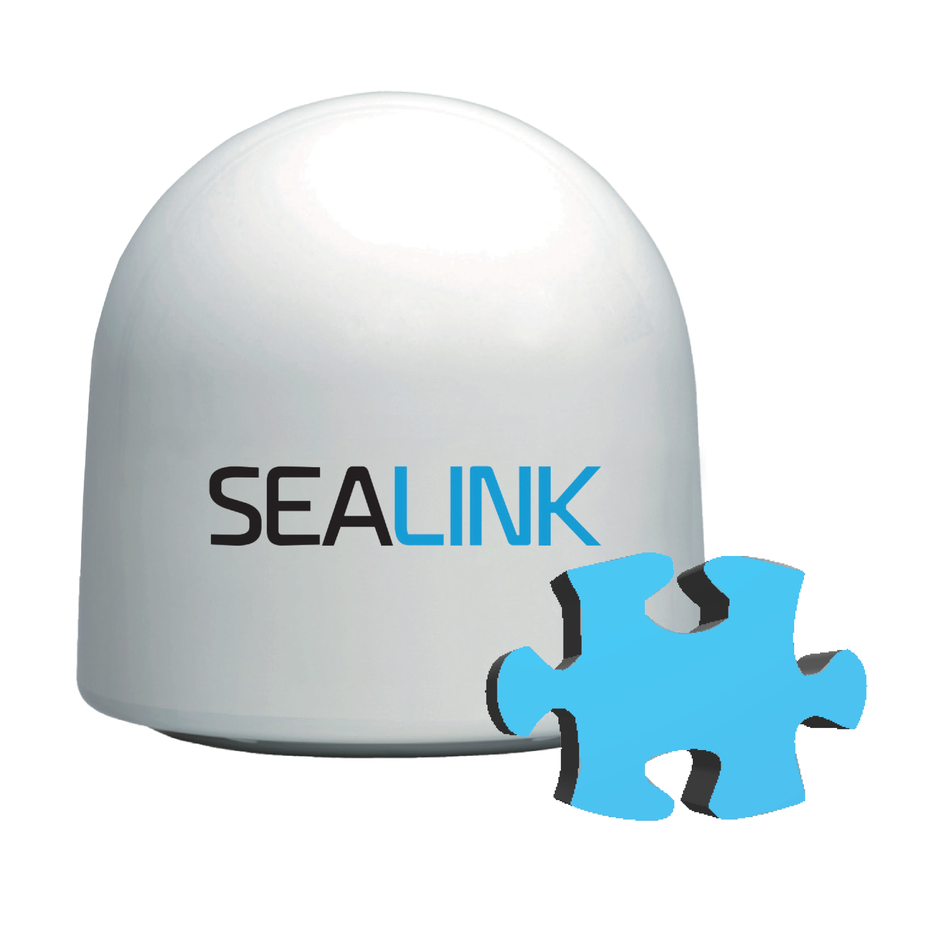
Full Range of Maritime Connectivity
Sealink
Premium
Up to 8 Mbps as standard
Unlimited usage
Inmarsat
Fleet Xpress
Up to
4 Mbps GX Ka- Band
Telenor
Anker
Up to 30 Mbps
Regional Ka-band
Sealink
Allowances
From 500MB to 80GB per month
Sealink
Business
with guaranteed speeds (CIR)
Iridium Certus
Up to 700 Kbps monthly allowances
Inmarsat
FleetBroadband
Up to 432 Kbps
Thuraya
MarineComms
Up to 444 Kbps
Iridium
OpenPort
Up to 128 Kbps pole to pole coverage
Inmarsat C
Message Polling Data Reporting
Inmarsat
FleetOne
Up to 100 Kbps
Iridium SBD
M2M and tracking
Sealink Plus & Companion
Integrate MSS back-up and XChange
Hybrid Connectivity
Global4G & Tampnet
L-band MSS Solutions
Ka-band VSAT Solutions
Sealink Ku-band VSAT Solutions
DATA
USE
LOW MEDIUM HEAVY

Slide 10
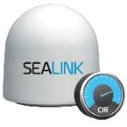
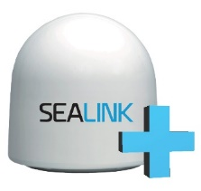
Maritime VSAT
SEALINK ALLOWANCES
Entry level VSAT/ Moderate users
GB Data Allowances
Alert notifications
Flexible top-up options
SEALINK BUSINESS
Guaranteed CIR
Budget-friendly data
19 Service Levels
Crew allocation
SEALINK
PREMIUM
CIR based
Unlimited usage
25 Service Levels
SEALINK PLUS
Full package:
Sealink VSAT,
MSS back-up (airtime & HW),
XChange communication platform
Medium Data Use
High Data Use

Slide 11
Sealink VSAT at a glance
SEALINK ALLOWANCES
Entry level VSAT/Heavy MSS users
GB Enforcement/ Monitored Usage (GBs)
Up to 6/1 Mbps MIR
Flexible top-up options
Alert notifications
Crew Prepaid Data
SEALINK BUSINESS
CIR based service
Up to 8 Mbps MIR
Caters for business usage on a budget
Applications requiring minimum bandwidth
19 Standard Service Levels
Fair Access Policy
SEALINK PREMIUM
CIR based service
Up to 8 Mbps MIR
Unlimited service/usage without throttling MIR
Less constraints
25 Standard Service Levels
Market Segments:
Market Segments:
High Data Use
Market Segments:
Moderate Data Use
Basic Data Use

Slide 12
Sealink Product Portfolio
 | CURRENT MSS USERS | GLOBAL COVERAGE | REGIONAL COVERAGE | LAYUP OPTIONS | CREW COMS | PASSENGER / 3RD PARTY COMS | SEALINK + - BACKUP SERVICES | DATA MANAGEMENT – GB | GUARANTEED SPEED - CIR | UNLIMITED USAGE
SEALINK PREMIUM |  | ✓ | ✓ | ✓ | ✓ | ✓ | ✓ | ✓ | ✓ | ✓
SEALINK BUSINESS | ✓ | ✓ | ✓ | ✓ | ✓ |  | ✓ | ✓ | ✓
SEALINK ALLOWANCES | ✓ | ✓ |  | ✓ | ✓ |  | ✓ | ✓

Slide 13
Sealink Product Portfolio
Features | Sealink Allowances | Sealink Business | Sealink Premium
Coverage | Global only | Global and 6 regions | Global and 6 regions
Beam diversity | Multiple beams | Multiple beams | Multiple beams
FAP | No | Yes | No
Quota | Yes | No | No
CIR | No | Guaranteed | Guaranteed
MIR | Up to 6 Mbps | Up to 8 Mbps | Up to 8 Mbps
Service availability | 99.5% | 99.5% | 99.5%
SLA | Standard | Standard | Standard
MSS back-up options | Plus/Companion | Plus/Companion | Plus/Companion
Upgrades | Top-ups in month Permanent upgrades only | Permanent only (shorter subject to approval) | Permanent only (shorter subject to approval)
Vessel type focus | Merchant, Fishing | Merchant, Fishing, OSV | Tankers, Yachting, Fishing
Antenna | 60cm/80cm/ 85cm/ 1m | 85cm/1m | 60cm/ 80cm/ 85cm/ 1m
Contract commitment | 12 months, shorter possible with mark-up | 12 months, shorter possible with mark-up | 12 months, shorter possible with mark-up

Slide 14
SEALINK ALLOWANCES
Allowances of 500MB, 1GB, 2GB, 5GB, 10GB, 20GB, 30GB, 40GB, 60GB and 80GB per month
2-4 high quality voice lines
Burst rates up to 6 Mbps
Best global Ku-band coverage
Packaged with industry leading 60cm or 80cm+ class antenna from Intellian or Cobham
Monitor usage, set limits and alerts
Never turned off: throttled
Easily top-up if needed via Portal360
01
SEALINK ALLOWANCES

Slide 15
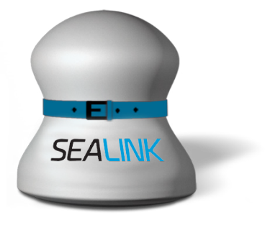
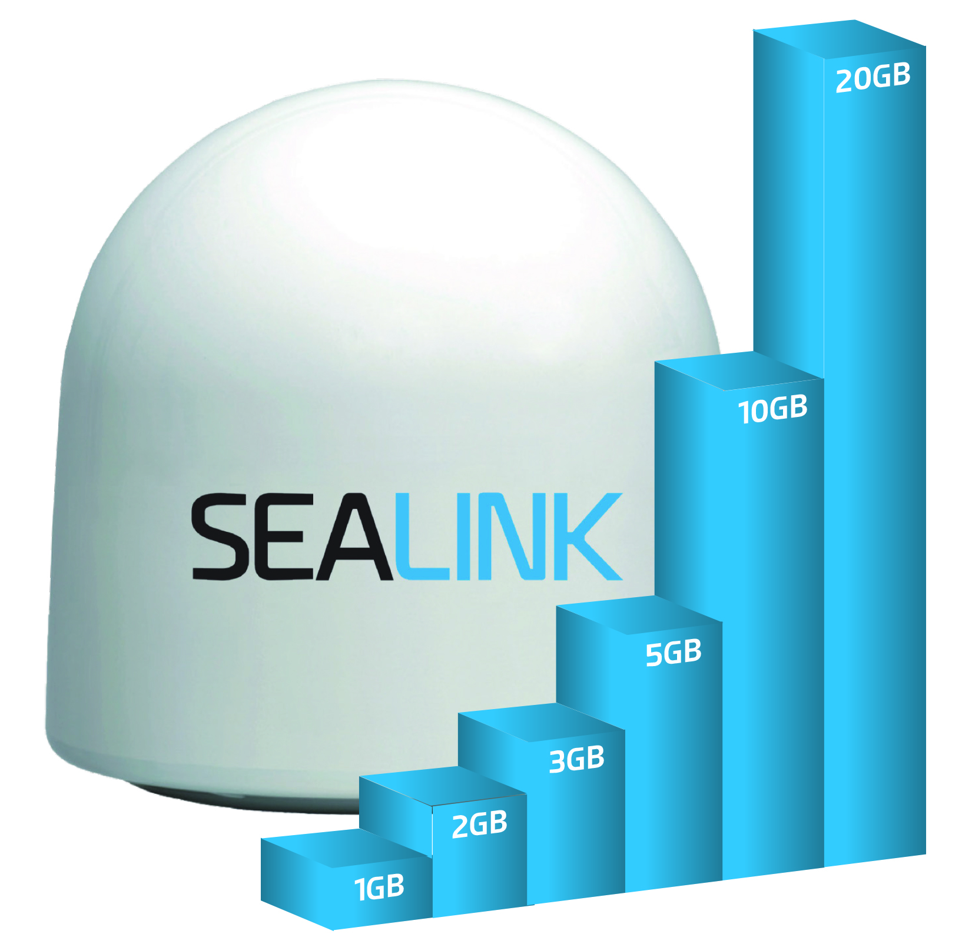
Sealink Allowances
High speed bandwidth when you need it, empowering business-critical applications
Choose the allowance plan to fit your vessel’s needs
When consumed, data speed is reduced, giving priority to business critical data & voice
New Sealink Crew Prepaid Service - add separate prepaid web access for crew, outside of the allowance quota*
High Speed Connection
Set your own usage quota alert (e.g. at 90% or 95%)
Traffic is throttled
but never turned off
Easy online top-up: 1GB, 2GB, 3GB, 5GB, 10GB & 20GB
*Available with Sealink 2020 Allowances. Full terms and conditions apply.

Slide 16
Sealink Allowances Service Plans
+20 GB
+10 GB
+5 GB
+3 GB
+2 GB
+1 GB
TOP-UP OPTIONS
500 MB
1 GB
2 GB
5 GB
10 GB
20 GB
30 GB
40 GB
60 GB
80 GB
DATA BUNDLES
60cm antenna: 1, 5, 10 & 20 GB allowances only

Slide 17
Sealink Allowances - Crew Prepaid Option
Sealink Crew Prepaid Service
Especially recommended for lower data Allowance Plans - provides new opportunities for crew welfare
Prepaid web access for crew members
Crew data use is separate from vessel’s data allowance plan
Prepaid access credit can be ordered by the captain from Marlink and resold to the crew onboard
Available with new Sealink 2020 Allowances (see T&Cs for further info)

Slide 18
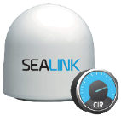
SEALINK BUSINESS
Data speeds of up to 8 Mbps
Choice of 19 service levels with Committed Information Rates (CIR) from 64 Kbps to 2 Mbps
2 - 8 quality voice lines
Best global Ku-band coverage
Packaged with industry leading 80cm+ class antenna from Intellian or Cobham
Fair Access Policy
02
SEALINK
BUSINESS

Slide 19
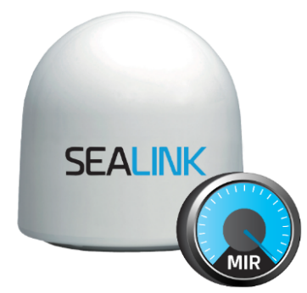
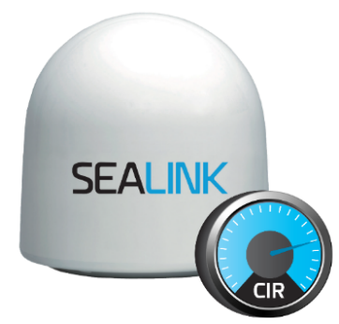
Sealink Business
19 Service Levels with guaranteed minimum
MIR could be set equal to CIR allowing priority to business-critical data & voice with Fair Access Policy
CIR guaranteed,
with bursting to MIR
Fair Access Policy met,
MIR can be reduced to CIR
At the start of the new month, CIR guaranteed with bursting to MIR restored

Slide 20
Sealink Business Service Levels – 80cm+ antenna
Service (in Kbps) |  |  |  | Standard no. of Voice Lines
Shore to Ship |  | Ship to Shore
MIR | CIR | MIR | CIR
512 | 64 | 512 | 64 | 2
1024 | 128 | 512 | 64 | 2
1024 | 128 | 1024 | 128 | 4
1536 | 192 | 512 | 64 | 4
1536 | 192 | 1024 | 128 | 4
2048 | 256 | 1024 | 128 | 4
2048 | 256 | 2048 | 256 | 4
3072 | 384 | 1024 | 128 | 4
3072 | 384 | 2048 | 256 | 4
4096 | 512 | 1024 | 128 | 4
4096 | 512 | 2048 | 256 | 4
4096 | 512 | 3072 | 512 | 4
4608 | 768 | 2048 | 256 | 4
4608 | 768 | 3072 | 512 | 4
6144 | 1024 | 3072 | 512 | 4
6144 | 1280 | 3072 | 512 | 4
6144 | 1024 | 4096 | 1024 | 4
8192 | 1536 | 3072 | 512 | 4
8192 | 2048 | 4096 | 1024 | 4
Refer to Marlink General Terms and Conditions and Service Description for Sealink Service.

Slide 21
SEALINK PREMIUM
Data speeds of up to 8 Mbps
Unlimited usage
Choice of 25 service levels with constant Committed Information Rates (CIR) from 64 Kbps to 5 Mbps
2 - 8 high quality voice lines
Best global Ku-band coverage
Recreational crew internet and WiFi access with filtering capabilities
Packaged with industry leading 60cm or 80cm+ class antenna from Intellian or Cobham
03
SEALINK
PREMIUM

Slide 22
Sealink Premium – 80cm+ Antennas
Service (in Kbps) |  |  |  | Standard no. of Voice Lines
Shore to Ship |  | Ship to Shore
MIR | CIR | MIR | CIR
512 | 64 | 512 | 64 | 2
1024 | 128 | 512 | 64 | 2
1024 | 128 | 1024 | 128 | 4
1536 | 192 | 512 | 64 | 4
1536 | 192 | 1024 | 128 | 4
2048 | 256 | 1024 | 128 | 4
2048 | 256 | 2048 | 256 | 4
3072 | 384 | 1024 | 128 | 4
3072 | 384 | 2048 | 256 | 4
4096 | 512 | 1024 | 128 | 4
4096 | 512 | 2048 | 256 | 4
4096 | 512 | 3072 | 512 | 4
4608 | 768 | 2048 | 256 | 4
4608 | 768 | 3072 | 512 | 4
6144 | 1024 | 3072 | 512 | 4
6144 | 1280 | 3072 | 512 | 4
6144 | 1024 | 4096 | 1024 | 4
8192 | 1536 | 3072 | 512 | 4
8192 | 2048 | 4096 | 1024 | 4
6144 | 2560 | 4096 | 1024 | 4
6144 | 3072 | 4096 | 1024 | 4
6144 | 3584 | 4096 | 1024 | 4
6144 | 4096 | 4096 | 1024 | 4
6144 | 4608 | 4096 | 1024 | 4
6144 | 5120 | 4096 | 1024 | 4
Refer to Marlink General Terms and Conditions and Service Description for Sealink Service.

Slide 23
Sealink Premium – 60cm antennas
Service (in Kbps) |  |  |  | Standard no. of Voice Lines | Maximum no. of Voice Lines
Shore to Ship |  | Ship to Shore
MIR | CIR | MIR | CIR
256 | 32 | 256 | 32 | 2 | 2
512 | 64 | 256 | 32 | 2 | 2
512 | 64 | 512 | 64 | 4 | 5
1024 | 128 | 512 | 64 | 4 | 5
1024 | 128 | 512 | 128 | 4 | 5
2048 | 256 | 512 | 64 | 4 | 5
2048 | 256 | 512 | 128 | 4 | 8
2048 | 256 | 512 | 256 | 4 | 8
3072 | 512 | 512 | 128 | 4 | 8
In certain regions the MIR on the ship-to-shore direction may be limited to 256 Kbps due to regulations.

Slide 24
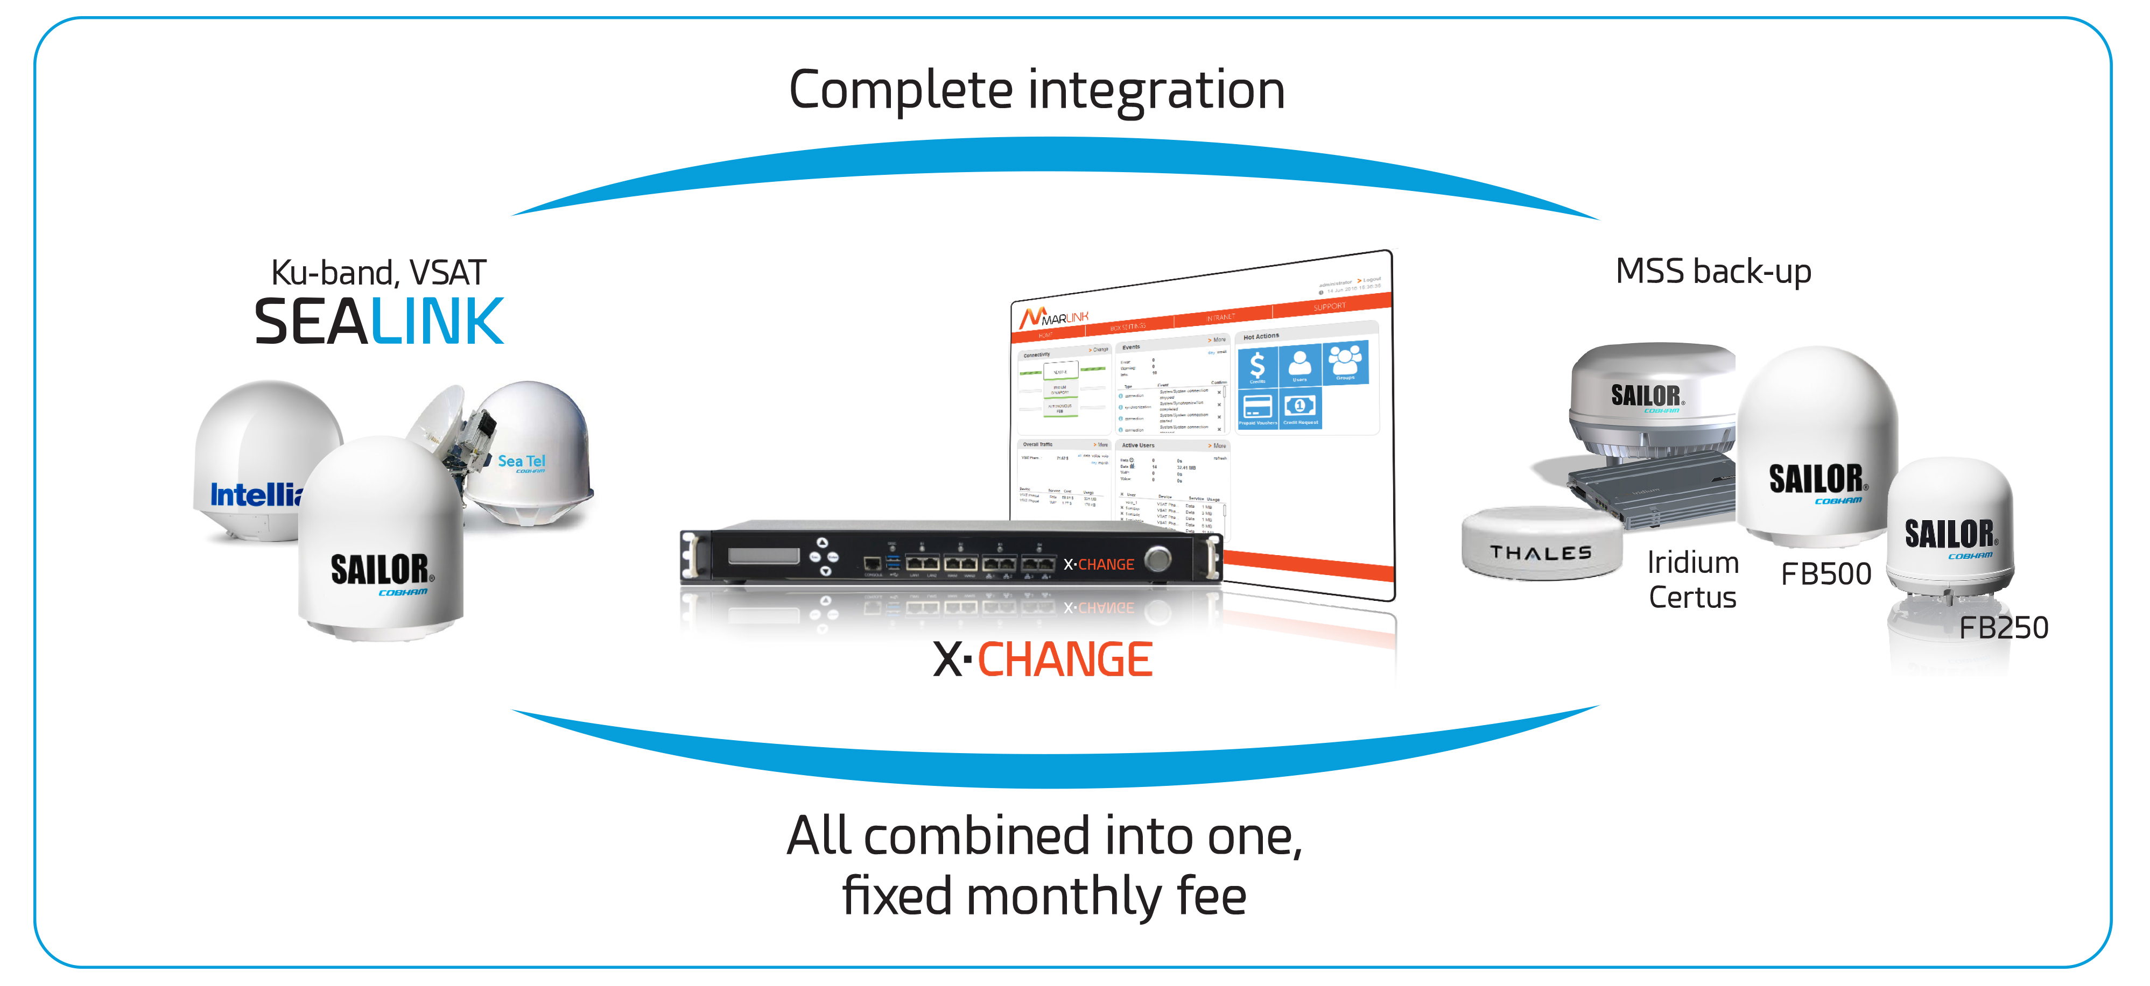
Sealink Options – Sealink Plus and Companion
Combines:
Global VSAT with the best Ku-band coverage
Available for Sealink Allowances, Business or Premium
Extra large GB allowances: up to 80 GB per month
Or guaranteed speeds with CIR
Unlimited MSS back-up
MSS airtime and hardware included
Iridium Certus, OpenPort or Inmarsat FleetBroadband
Alternatively, the Sealink Companion option enables you to add an MSS backup allowance plan to any Sealink Connectivity
XChange communication management platform
Centralised VoIP, data and internet access
Automatic fallback switching from MSS
Optional Bring Your Own Device solution and Internet Café
Fully integrated Value Added Services

Slide 25
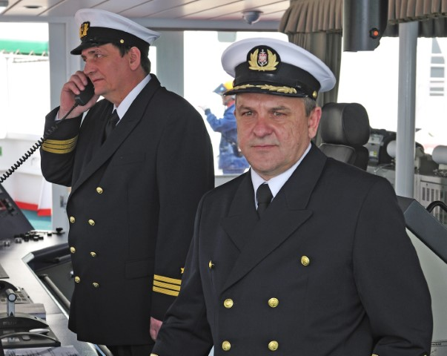
Sealink Voice Options
Sealink’s voice service uses high priority VLANs for voice transmission and dedicated bandwidth to ensure the market’s leading voice quality
Post paid voice:
High quality service
Terminated into the PSTN network
Pay-as-you-go voice groups:
Destination Group A
Destination Group B
Destination Group C
Destination Group D
Destination Group E
Destination Group F

Slide 26
4G Services
Marlink 4G Services is our portfolio of multicarrier (3G/4G LTE, Tampnet) solutions that complement Sealink™ VSAT.
Global 4G
Marlink Global 4G extends the portfolio of connectivity services by introducing terrestrial 4G SIMs. It is a truly global offer allowing the use of 1 SIM card in over 110 countries across all regions.
We offer attractive money allowance packages to suit all business and leisure needs with speeds up to 300 Mbps on 4G+.
This service is integrated in Marlink infrastructure and can be combined with Value Added Services (E.g.: filtering & cyber security services).
North Sea and Gulf of Mexico LTE Coverage
Tampnet low-latency 4G service with data rates of up to 50 Mbps, available in the North Sea and in the Gulf of Mexico.
Tampnet operates the largest offshore high capacity communication network in the world, carrying traffic for approximately 200 platforms and a large number of vessels in the Norwegian, Danish and UK sector of the North Sea.
Near Coastal Communications
Optional WiFi – connect to wireless networks with bandwidth up to 100 Mbps when ports are within reach.

Slide 27
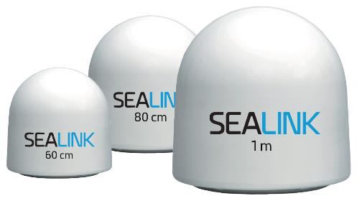
Choice of Reliable Equipment
Sealink VSAT Service | 85cm or larger | 80cm | 65cm & 60cm
Antenna Models | Sealink Standard Antenna Intellian v85NX Sailor 800/1000 XTR Intellian v100NX Intellian v130NX | Intellian v80E | Intellian V60E Sailor 600 XTR
Sealink Allowances | MIR Up to 6 Mbps / 1024 Kbps All allowance plans | MIR Up to 6 Mbps / 1024 Kbps All allowance plans | MIR Up to 6 Mbps / 512 Kbps 1, 5, 10 & 20GB
Sealink Business | MIR Up to 8 Mbps CIR 64 Kbps to 2 Mbps | - | -
Sealink Premium | MIR Up to 8 Mbps CIR 64 Kbps to 5 Mbps | - | MIR Up to 3 Mbps CIR 32 to 512 Kbps
Service Area | Out to 5° elevation lines | Out to 5° elevation lines | Out to 10° elevation lines
CIR Availability (Premium & Business) | 99.5% | - | 95%
Weights | 85 cm. 105 kg/231.5 lbs 1m approx. 139.5 kg/307.5 lbs 120 kg/264.5 lbs (Sailor 1000 XTR) | 80cm approx. 76Kg/167.5 lbs | 60cm approx. 42 kg/92.6 lbs (V60E)
Newtec Dialog Modem (from ST Engineering iDirect)
XChange Base, XChange Power or XChange Router (recommended)
Equipment Rack, UPS, Cables & Connecters (optional)
Equipment leasing options available

Slide 28
Sealink Network – Coverage Highlights
Marlink Ku-band
Extensive global coverage
Multiple regional coverage areas
2 yachting High Speed Zone areas
HTS spot beams
72 satellite beams
45 satellites
Marlink C-band
Extensive global coverage
Multiple regional coverage areas
13 satellite beams
10 satellites
Map depicts an approximation of coverage, does nor guarantee service availability and is subject to change

Slide 29
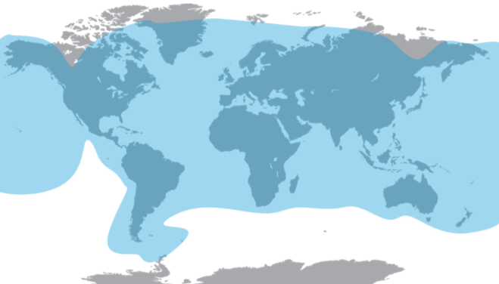
Sealink Ku-band Global Coverage
Map depicts an approximation of coverage, does nor guarantee service availability and is subject to change

Slide 30
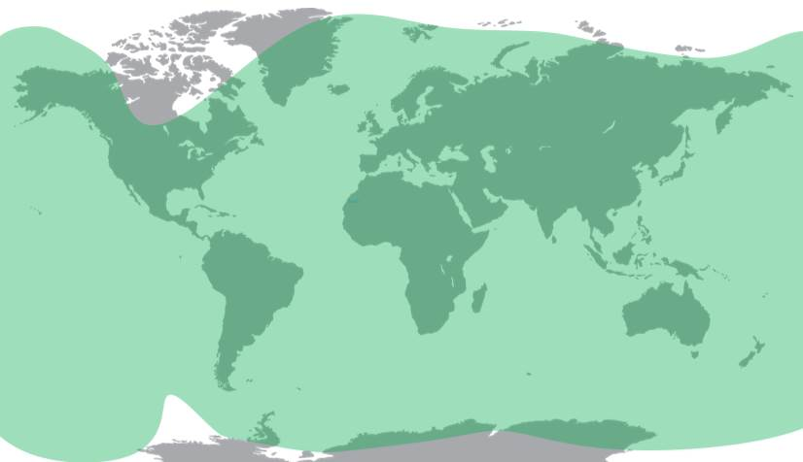
Sealink C-band Global Coverage
Map depicts an approximation of coverage, does nor guarantee service availability and is subject to change

Slide 31
Marlink’s Digital Solutions
Marlink Digital Solutions are expertly designed to optimise satcom connectivity at sea and help customers digitalise their operations.
06
DIGITAL SOLUTIONS

Slide 32
Digital Solutions
Complete suite of integrated, fully managed IT, IoT and Cyber Security solutions to digitise your operations.
IT
Solutions
Cyber Security
Crew & Worker Welfare
Simplify and automate your vessel IT to ensure effective operations and compliance.
Designed specifically to support your remote IT operations, ITLink provides secure connectivity management, automated application updates, file transfer and data sharing.
Effectively secure your vessel and remote assets from cyber risk with our CyberGuard portfolio.
From scanning network traffic to automating anti virus updates, CyberGuard provides a full suite of solutions to protect your vessels from advanced, targeted threats.
Enable your crew and remote workers to stay connected, safe and healthy. Prepaid voice & data and on-board Wi-Fi provide your crew with the essential connectivity, while daily news and remote medical assistance enable reliable support and information.
Powered by XChange: centralised IT and communications management

Slide 33
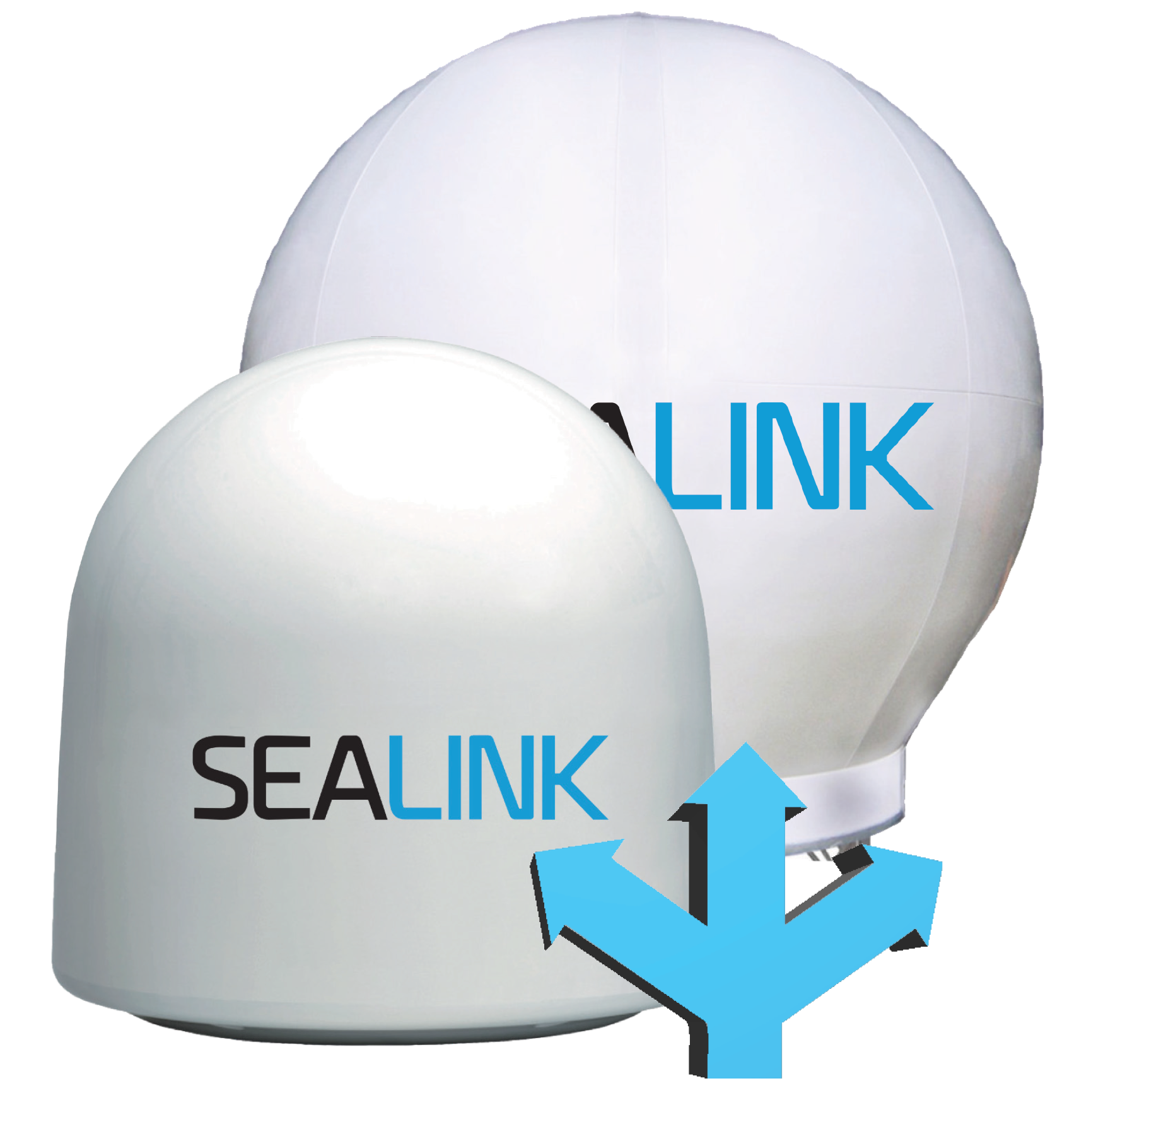
Sealink Integrated Solutions
Seamlessly integrated VAS | Sealink Allowances | Sealink Business | Sealink Premium | Sealink Flex
SkyFile Mail Optimised email, fax & SMS | ✓ | ✓ | ✓ | ✓
SkyFile eNoad |  | ✓ | ✓ | ✓
Sealink Crew Prepaid | ✓
Universal Card Manager for End-user | ✓ | ✓ | ✓ | ✓
Universal Card Crew Order |  | ✓ | ✓ | ✓
Universal Card Managed Prepaid | ✓ | ✓ | ✓ | ✓
Data Manager Basic Preconfigured firewall | ✓ | ✓ | ✓ | ✓
Data Manager Premium Web Filtering | ✓ | ✓ | ✓ | ✓

Slide 34
Teams of experts to manage your network solution
Logistics
Field Service
Network Operations
Service Desk
Logistics: 9 warehouses worldwide for testing, configuring and storing all equipment and hardware
Field Service: Global team of engineers for fast, professional field services, installation, repair, upgrades, replacement etc.
Network Operations: To manage your network solutions end-to-end, for troubleshooting, testing and training
Service Desk: 24/7 global customer support with multilingual staff for immediate assistance

Slide 35
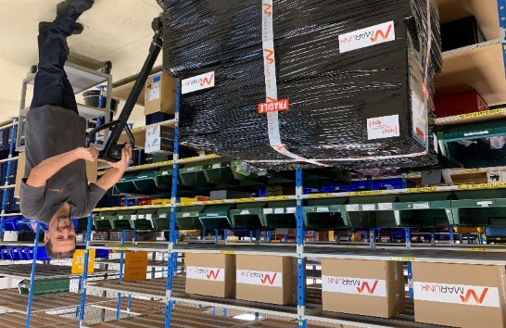
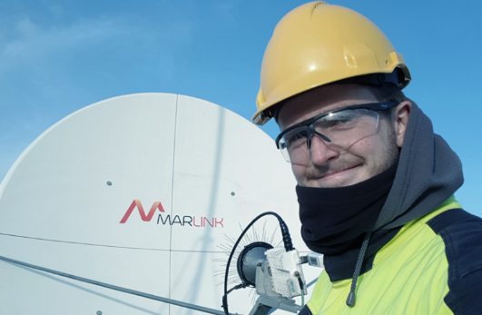
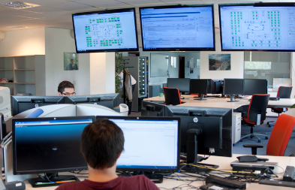
Global Customer Support
Logistics
Field Service
Network Operations
Service Desk
9 warehouses worldwide
Equipment pre-testing
Short delivery times
Administrative assistance
Handling of spares and repairs
Software upgrades
Special configuration
Delivery, Installation & Maintenance
Fast, professional field services in 1000+ ports and 135 countries
HSE-compliant, BOSIET and HUET trained
Repair, upgrades, migration, replacement
Service & call-outs
Technology agnostic
ITIL v3
IT Lean
Troubleshooting
Resolution of complex incidents
Training, hands-on demonstrations
Applications testing
Project management
24/7 Global Customer Care
Multi-lingual staff
Immediate support
Activation/deactivation of terminals, SIMs
Administrative and billing assistance
Guidance and tips

Slide 36
Marlink's Centre of VSAT Operational Excellence
Marlink’s high bandwidth customers can access dedicated support from the Maritime Network Operations Center (MNOC) located at Eik Teleport, Norway.
The MNOC is built up of Antenna and Network Engineers with long experience supporting Maritime VSAT solutions
The MNOC handles all standard changes to the vessel during the contract life cycle, such as bandwidth and coverage changes as applicable and can gain direct remote access to your vessel and proactively monitor onboard connectivity performance around-the-clock
A Dedicated Service Manager can work with you daily to monitor your business and handle installations and changes
The Service Manager proactively reports and manages all service level achievements, to ensure optimal service delivery
“Marlink’s dedicated technicians are very reliable and committed to delivering excellent quality of service.”
Raimo Warkki, Commercial Ship Communications & Systems Stena IT

Slide 37
Global Customer Support
Eik (NO)
Stavanger (NO)
Rotterdam (NL)
Bratislava (SK)
Choisy Le Roi (FR)
Piraeus (GR)
Houston (US)
Aussaguel (FR)
Dubai & Qatar
Manila (PH)
Service Desk
Singapore
IT Service Support
Maritime NOC
Rio de Janeiro (BR)
Enterprise NOC
Logistics (Warehouse)

Slide 38
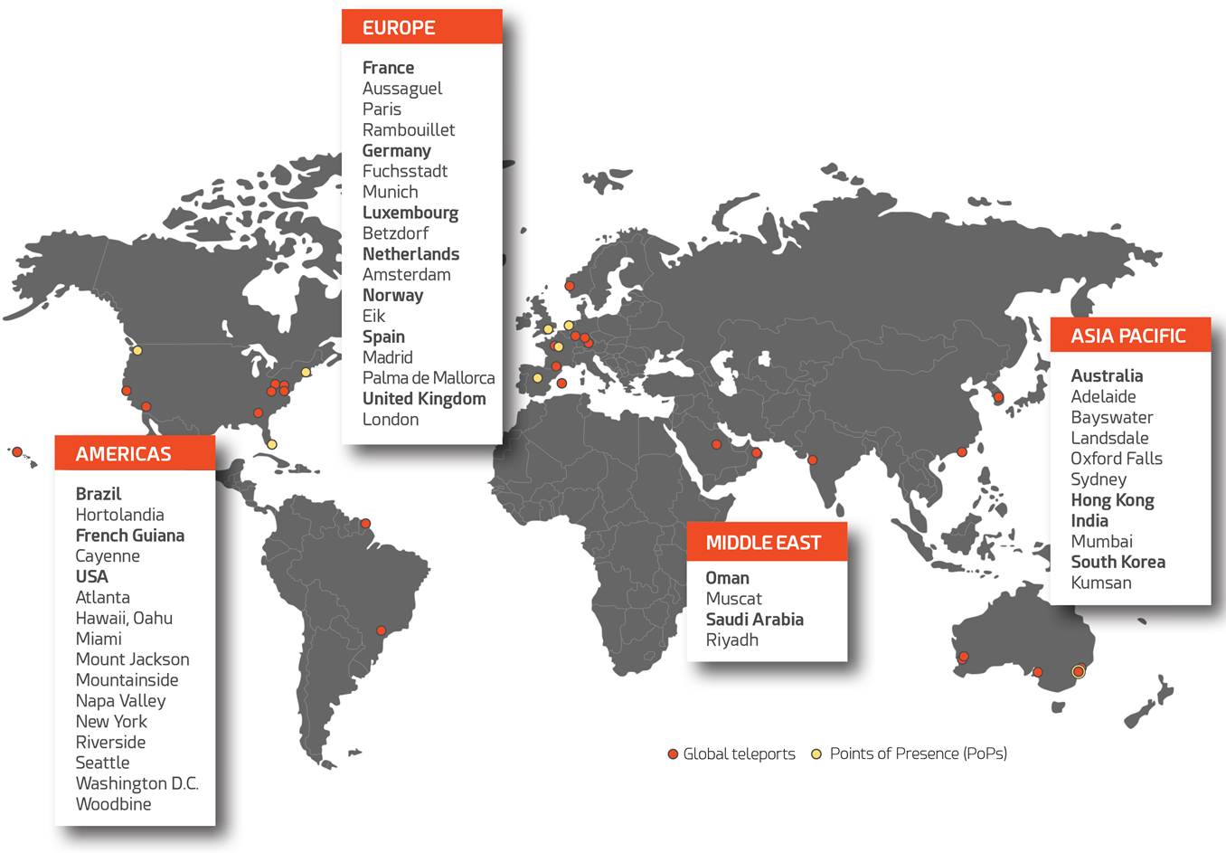
Global Network Infrastructure

Slide 39
Sealink VSAT SLA
Feature | Standard SLA | Extended SLA | Dedicated SLA
Means of incident reporting | Phone or email | Phone or email | Phone or email
Response time | 24 hours | 2 hours by phone 4 hours by email | 2 hours by phone 4 hours by email
Remote troubleshooting time | 24 hours | 24 hours | 24 hours
Mobilization time | 72 hours | 48 hours | 48 hours
Dedicated Service Manager | N/A | N/A | Included
Trouble Ticket Updates | N/A | N/A | 12 hours

Slide 40
Sealink Free Trial Promotion
Trial 3 months airtime and antenna lease applicable
for all Sealink services.
For trials on one vessel in a fleet
Available now

Slide 41
Every third vessel at sea sails with Marlink services today. Join Us!

Slide 42
Thank You!

